Slide 1
(CS422)-Human Computer Interaction
Behraj Khan
National University of Computer and Emerging Sciences

Slide 2
Things in which Computer are embedded
ATM, cell phone, VCR, remote control, ticketing machine, digital personal organizers, calculator, watch, photocopier, toaster, bank, air conditioner, broadcasting, satellite, microwave, medical equipment, factories, companies

Slide 3
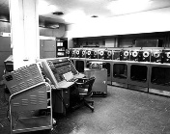
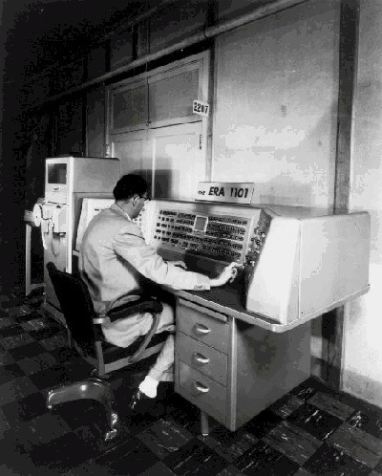
Computers in early era’s

Slide 4
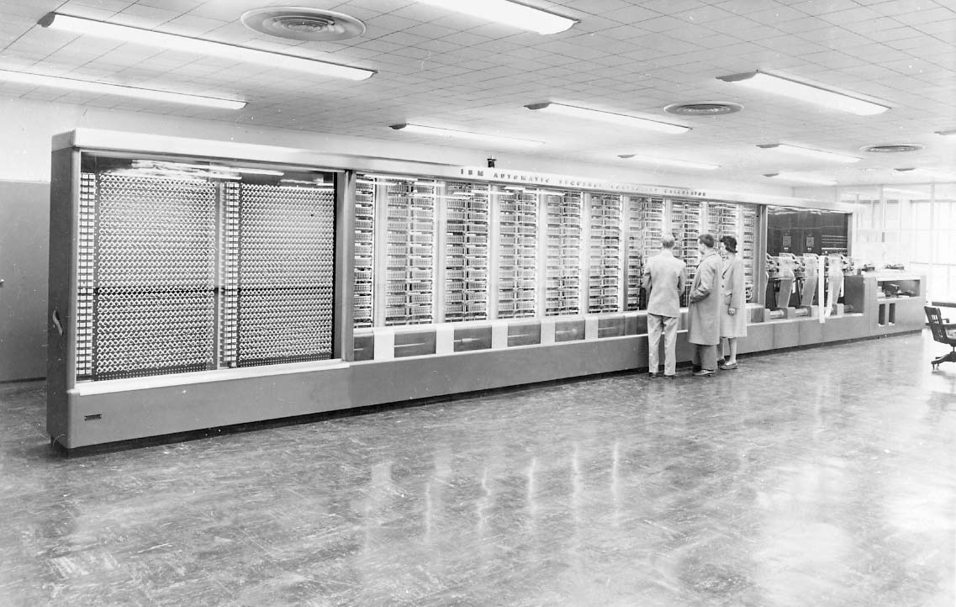

Slide 5

Continue…

Slide 6
Continue…
https://www.getsmarter.com/blog/market-trends/14-human-computer-interaction-examples/

Slide 7
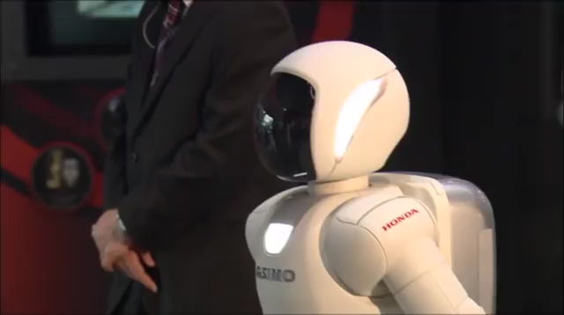
Artificial intelligence

Slide 8

Eye Gaze System

Slide 9


Slide 10
Bright and not so bright side of computers
Computers are enabling new discoveries
Leading to efficiencies
Making our life easy and convenient
Not so bright side
Computers are annoying us
They are infuriating us
They even kill a few of us

Slide 11
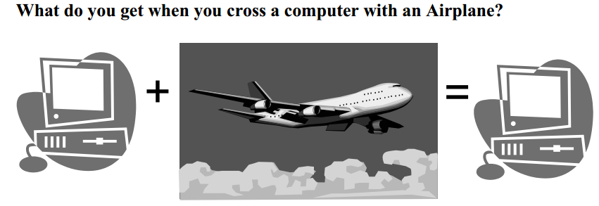
Continue…

Slide 12
Lion Air Boeing 737 Max 8 jetliner crashed
“glitch” in the plane’s flight-control software
killing all 189 passengers and crew

Slide 13
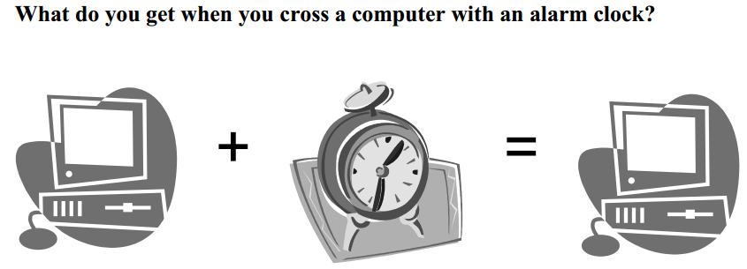
Jvc FS 2000 radio

Slide 14
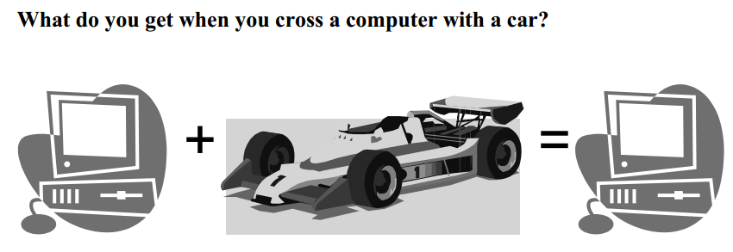

Slide 15
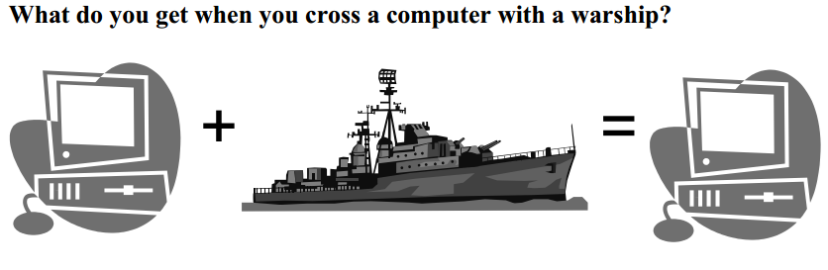

Slide 16
What is this course for?
Overview and introduction to Human Computer Interaction
Focus on how it applies to managers, technology executives, and others who will work with HCI professionals.
What HCI methods and HCI-trained specialists can bring to design and development teams.
Introducing tools and techniques for creating or improving interfacing user interfaces, such as Contextual Inquiry, Rapid Prototyping, Heuristic Analysis and Think-Aloud User Testing
Creating useful and usable design and systems
Every one from non-programmers to expert programmers are welcome

Slide 17
What is HCI?
Use computer science to solve people's needs and help them in everyday life.

Slide 18
What is HCI?
Human-Computer Interaction (HCI) is an interdisciplinary field in which computer scientists, engineers, psychologists, social scientists, and design professionals play important roles. The goal of this field is to solve real problems in the design and use of technology, making computer-based systems easier to use and more effective for people and organizations. Ease of use and effectiveness are critical to the success of any systems that interact with people, including software systems, home, office and factory appliances, and web and phone applications.
(Brad Myers)

Slide 19
Continue…
“Human-Computer Interaction is a discipline concerned with the design, evaluation and implementation of interactive computing systems for human use and with the study of major phenomena surrounding them”

